Slide 1
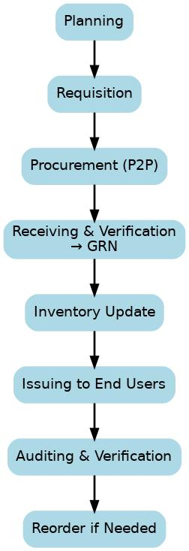
# INVENTORY MANAGEMENT

Slide 2
# PROCURE TO PAY (P2P)

Slide 3
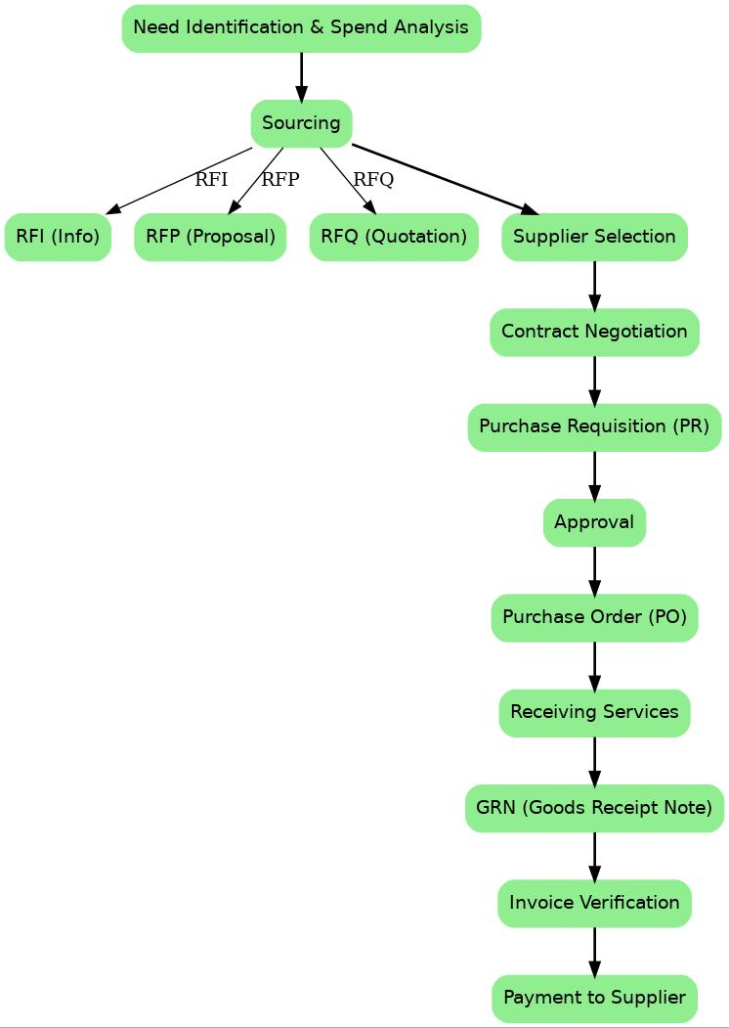
# SOURCETO PAY (S2P)

